Slide 1


PHP Development Course
MEC Academy

Slide 2
Agenda
Introduction in function
Importance of functions
Function's type
User-defined Function
Implementation
Dependencies
&
Issues / Risks
Schedule (High Level)
Completed Activities
Timeline
Action
Items
Change Requests

Slide 3



introduction
In general: is a way to perform some task.
In PHP: Functions in PHP are blocks of code that can be defined once and called multiple times throughout a script. They allow you to encapsulate code into reusable modules, making your code more modular and easier to maintain..

Slide 4
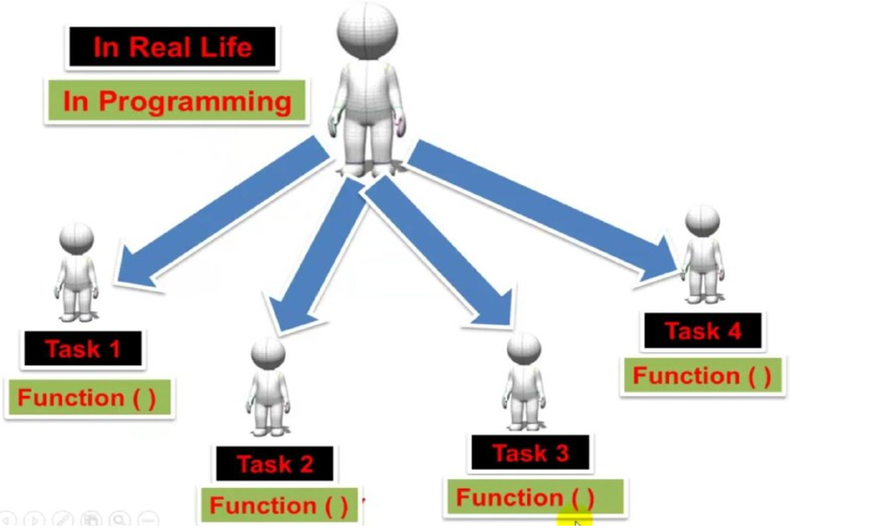

Slide 5



Importance of functions
Reusability
Time savers and help us to reuse code without retyping the code. Write one use many!
Maintenance
Make the maintenance process easier.
Manageable
It divides the code to tasks so that make it easier to control.

Slide 6
Function's type
Predefined Function
User-defined Function
Like; count($array), strlen($str).
written by the user or programmer, we just call it by it`s name.

Slide 7
User-defined Function
Normal user-defined Functions
Anonymous Functions
Callback Functions
Recursive Functions

Slide 8
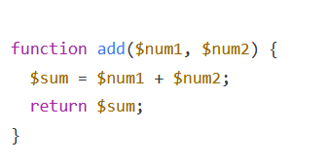
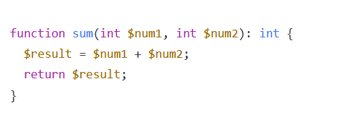

Normal User-defined Function
These are functions that you create yourself using the "function" keyword. You can define your own parameters and return values for these functions.
parameters
I don’t return any thing
//Call the function by its name!
arguments
Function name
Parameter List
Hint: Function signature => name of function and parameter list
Function task
What happened in memory when I call function?
Return type
What is deferent between function and method?

Slide 9
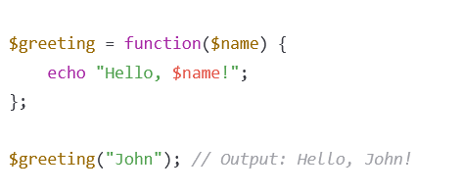
Anonymous Functions
In PHP, anonymous functions are also known as closures. They are functions that do not have a name and can be stored in a variable or passed as an argument to another function
use
Call back function

Slide 10
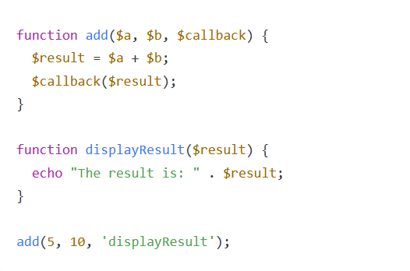
Callback Functions
These are functions that are passed as an argument to another function and are called when a certain event occurs.
array_map

Slide 11

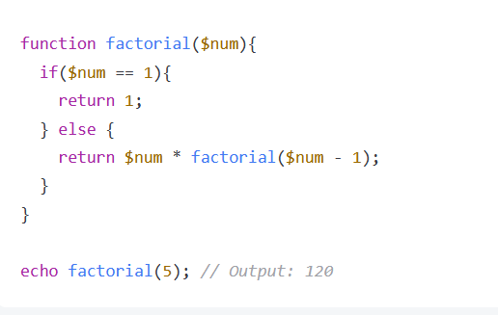
Recursive Functions
These are functions that call themselves either directly or indirectly. They are useful for solving problems that can be broken down into smaller sub-problems
Factorial(1) =1
Top =6
2*Factorial(1)
Top =5
3*Factorial(2)
Top =4
4*Factorial(3)
Top =3
5*Factorial(4)
Top =2
Factorial(5)
Top =1

Slide 12
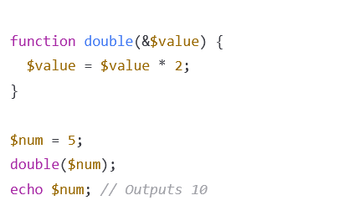
Passing Parameters by Reference
Passing by value Vs passing by reference

Slide 13
To Write Clean function
Use descriptive names: Choose meaningful and self-explanatory names for your functions that accurately convey their purpose.
Keep functions short and simple: Functions should ideally be kept short and focused on doing one thing well. If a function starts to become too long or complex, consider breaking it up into smaller sub-functions.
Use consistent formatting: Use consistent formatting such as indentation, line breaks, and curly brackets to make the code more readable and organized.
Avoid global variables: Avoid using global variables within your functions as they can lead to unexpected side effects and make debugging more difficult.
Minimize side effects: Functions should ideally have minimal side effects and not modify any external state, as this can make the code harder to reason about and test.
Handle errors gracefully: Always handle errors and exceptions in a consistent manner, providing clear error messages and returning early when appropriate.
Use comments sparingly: Comments can be useful for explaining complex logic or documenting code, but overuse of comments can make code harder to read.

Slide 14


